Slide 1

AML-2304 Natural Language Processing
Lambton College
School of Computer Studies
[Prepared By: Vahid Hadavi, PhD]

Slide 2
Module 3 3. Explain Text Wrangling and Cleansing
Major Topics:
3.1 Text Wrangling
3.2 Discuss Sentence Splitting
3.3 Define Word Tokenization
3.4 Explain Stemming and Lemmatization
3.5 Discuss Stop Words
3.6 Discuss Regular Expression (Regex)
3.7 Explain Bag-of-Words
3.8 Discuss TF-IDF

Slide 3
3.1 Text Wrangling

Slide 4
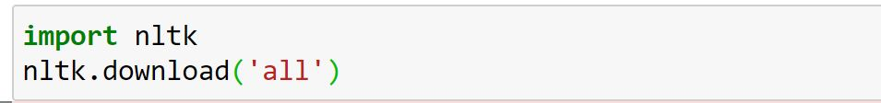
Text Wrangling
Text wrangling is the pre-processing work that’s done to prepare raw text data ready for training a machine learning model.
Simply put, it’s the process of cleaning your data to make it readable by your program.
It involves:
Sentence splitting
Tokenization
Stemming and lemmatization
Stop word removal.
To start Natural Language Toolkit (NLTK) needs to be installed.

Slide 5
3.2 Discuss Sentence Splitting

Slide 6
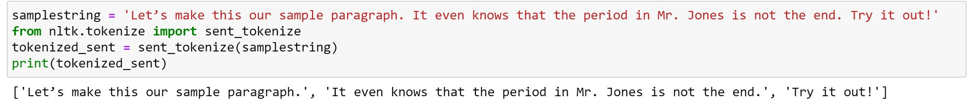
Sentence splitting
Sentence splitting (tokenization) is the process of splitting text into individual sentences.
sent_tokenize on NLTK is used to split text into sentences.
It needs the text name and the language of the text (English as default) as input.
It recognizes that the “.” in Mr. is not a period ending a sentence.

Slide 7
3.3 Define Word Tokenization

Slide 8
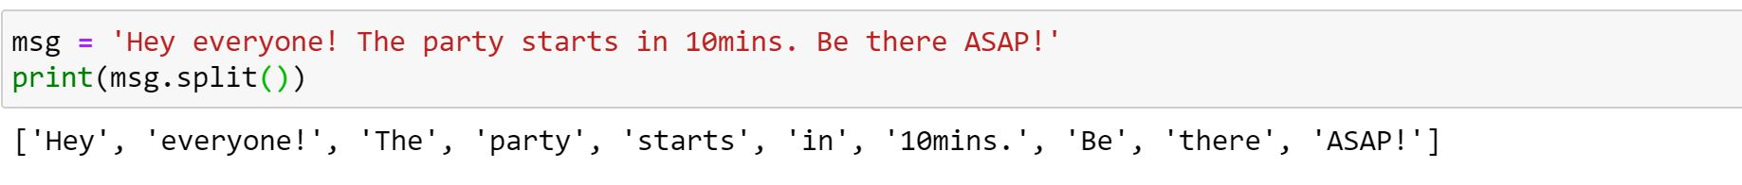
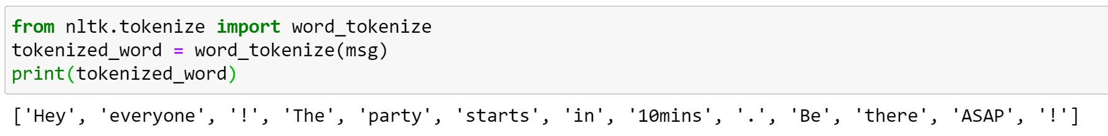
Word tokenizing
A token is the smallest text unit a machine can process.
Every chunk of text needs to be tokenized before you running natural language programs on it.
Python split() can be used to tokenize a text.
Word_tokenize on NLTK can be used to tokenize a text.
It needs the text name and the language of the text (English as default) as input.
Their outputs are slightly different. What are the differences?

Slide 9
3.4 Explain Stemming and Lemmatization

Slide 10
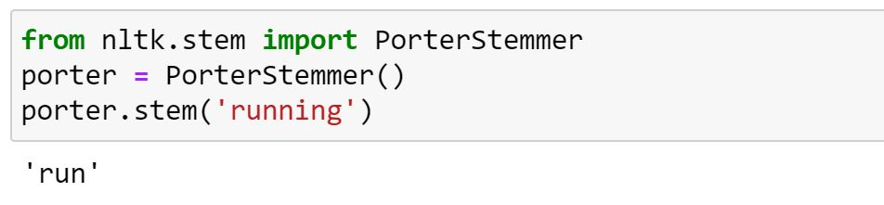
Stemming
Stemming is a text normalization technique used to extract the base form of the words by removing affixes from them.
Stemming algorithms work by cutting off the end or the beginning of the word, considering a list of common prefixes and suffixes that can be found in an inflected word.
Example: Jump-ing, Jump-ed, Jump-s
There are different algorithms in python for stemming.
The most common stemming algorithm in English is Porter stemmer.
It needs a word or a list of tokens as input.
There are other algorithms such as Snowball Stemmer that works well with other languages.
Jump

Slide 11
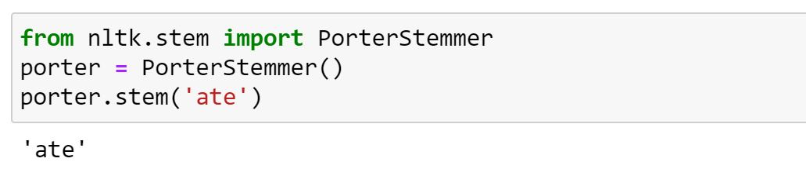
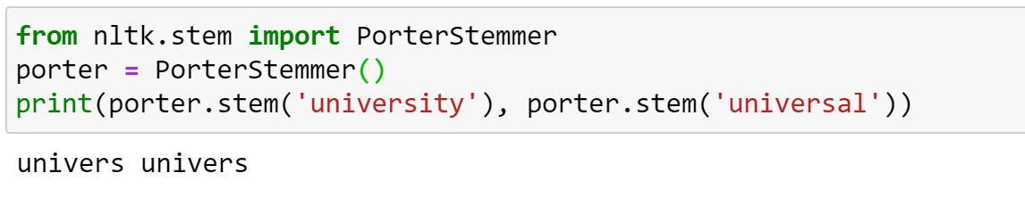
Stemming drawbacks
We expected to see “eat”.
“university” and “universal” are two different words with completely different meanings. Stemming returned a same root for both

Slide 12
Lemmatization
Lemmatization is a more advanced text normalization technique.
It considers context and part of speech to determine the lemma.
A lemma (plural lemmas or lemmata) is the canonical form, dictionary form of a set of words.
Python NLTK provides WordNet Lemmatizer that uses the WordNet Database to lookup lemmas of words.
Wordnet is database like a web of synonyms or a thesaurus.
Because lemmatization involves deriving the meaning of a word from something like a dictionary, it’s very time consuming.
You need to provide the context in which you want to lemmatize that is the parts-of-speech (POS).
You need to provide the word and pos (contect) as the input.
pos constants:
ADJ, ADJ_SAT, ADV, NOUN, VERB = 'a', 's', 'r', 'n', 'v'

Slide 13
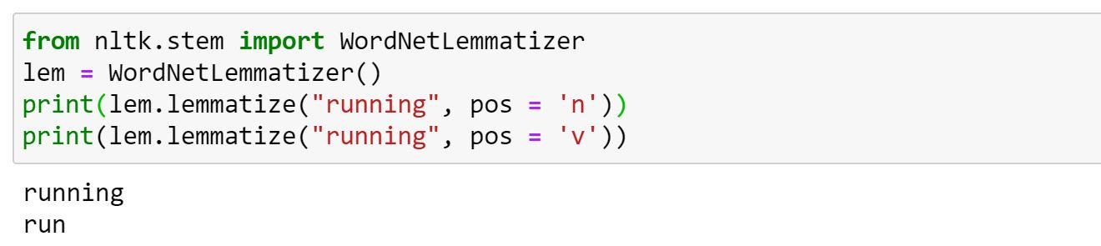
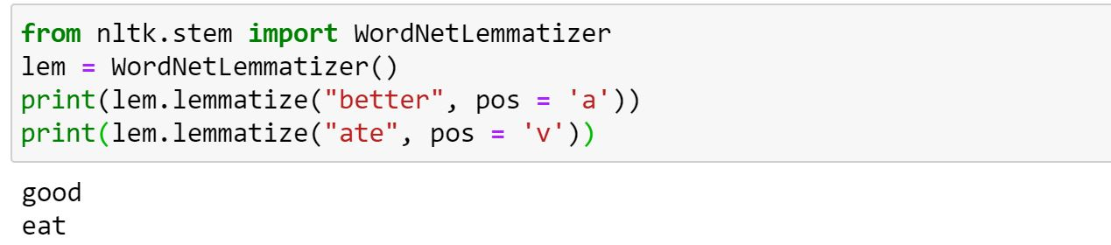
Lemmatization

Slide 14
3.5 Discuss Stop Words

Slide 15
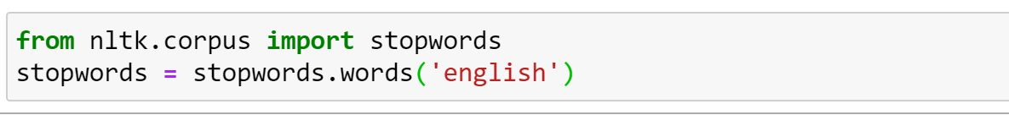
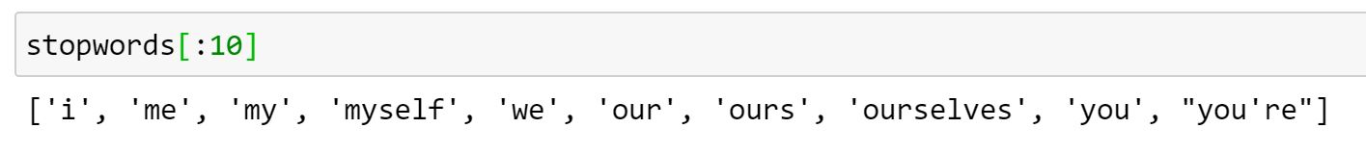
Stop Words
Stop words are commonly-used word that are usually ignored because of their many occurrences.
They do not add much meaning to a sentence.
Most of these words are articles and prepositions, such as “the”, “a”, “in”, etc.
These words can either end up taking too much space or eating up too much time.
NLTK has a list of stop words in 16 different languages.
First 10 words in the stopwords list:

Slide 16
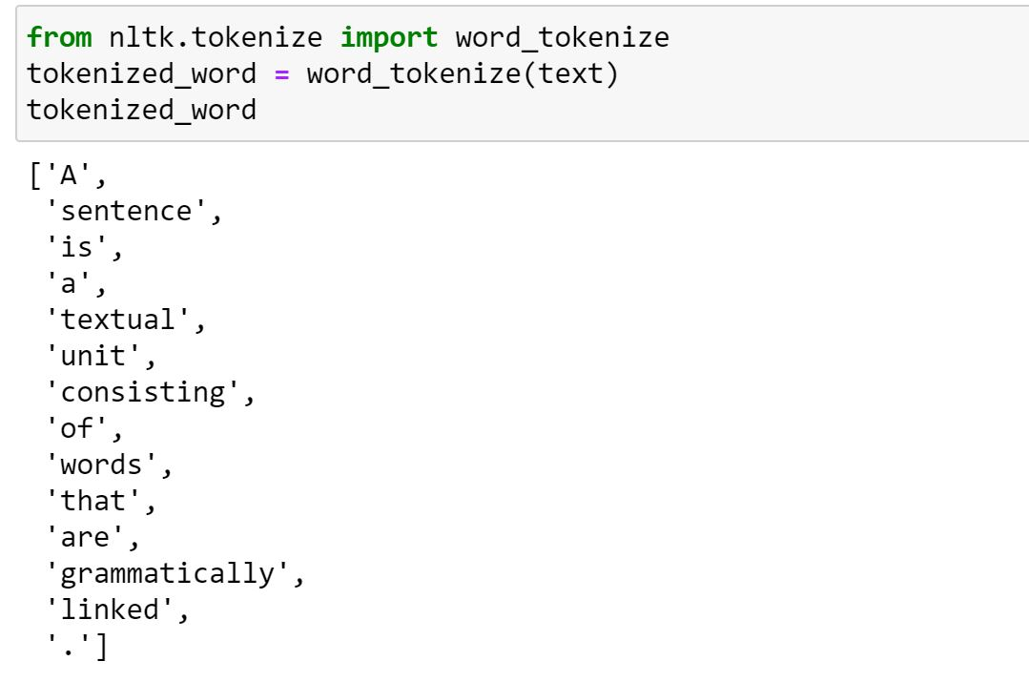
Stop Words removal
First, we tokenize the text.

Slide 17
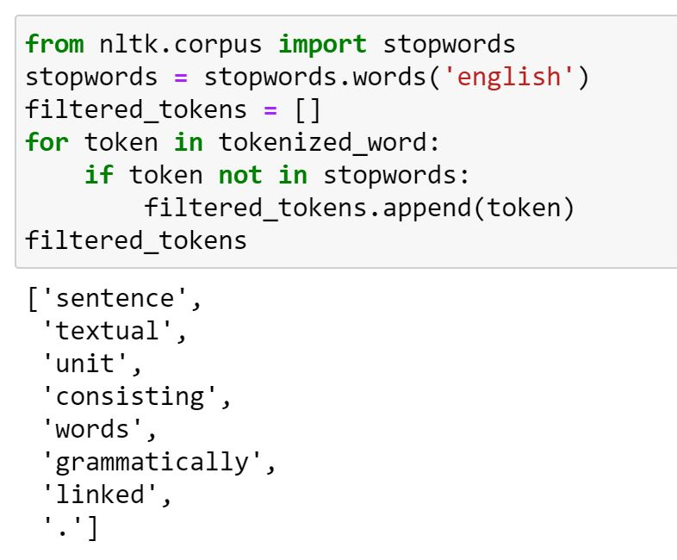
Stop Words removal
Now we filter out the stopwords.
‘a’, ‘is’, ‘that’, ‘are’ and ‘of were removed.

Slide 18
3.6 Discuss Regular Expression (Regex)

Slide 19
Regular expression (Regex)
Definition
A fascinating programming tool available within most of the programming languages.
A regular expression is a set of characters, or a pattern, which is used to find sub strings in a given string..
For example, extracting all hashtags from a tweet, getting email id or phone numbers etc.
To use it in python, you need to “import re”
Common Regex Functions
re.search(patterns, text)
Detects whether the given regular expression pattern is present in the given text.
re.match(patterns, text)
It returns a match object on success, None on failure.
re.sub(Pattern, Substitute, text)
It replaces the Pattern in the text with the Substitute.
re.findall(Pattern, text)
It returns a list of all the matches.

Slide 20
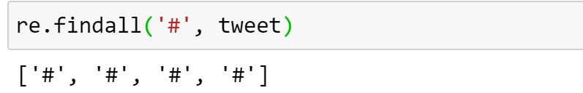
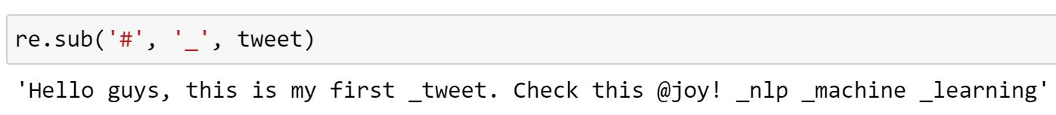
Regular expression

Slide 21
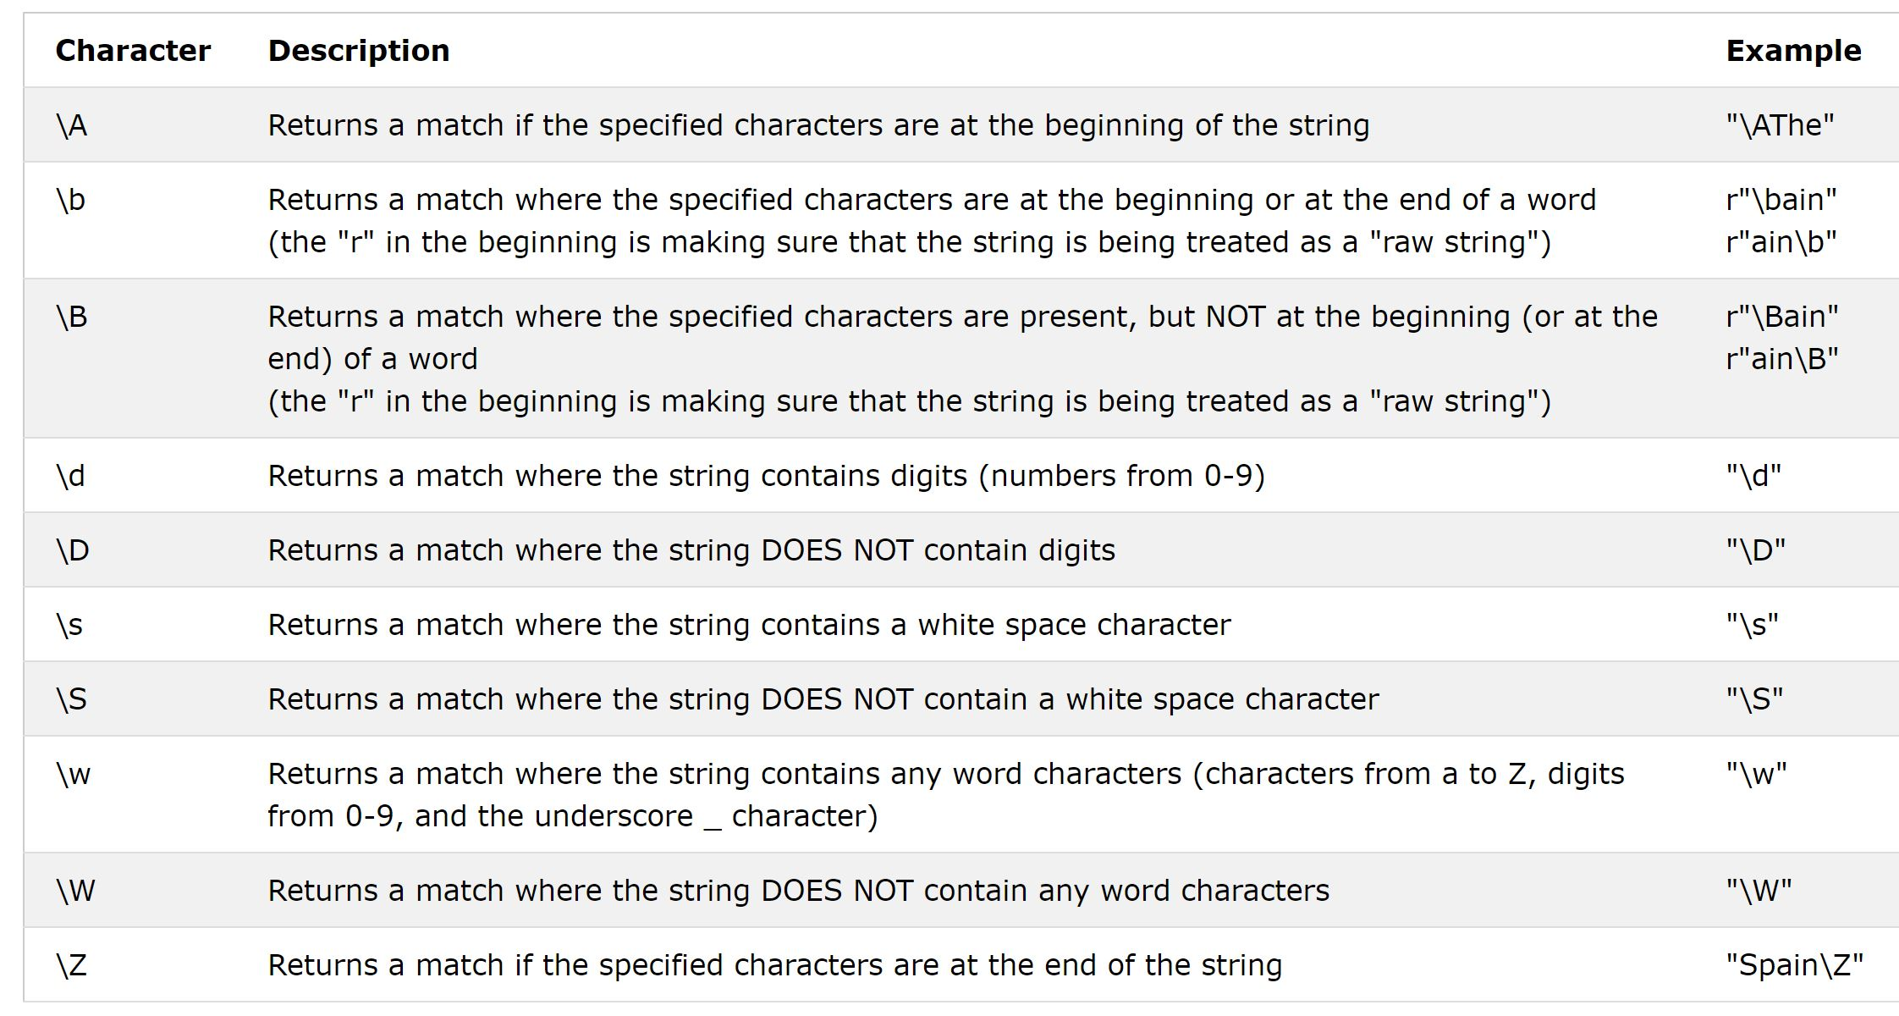
Special Sequences
A special sequence is a \ followed by one of the characters in the list below, and has a special meaning
A special sequence is a \ followed by one of the characters in the list below, and has a special meaning.
(Note : a backslash (\) and a forward slash (/)
Notes:
What is a raw string in Python?
Both string and bytes literals may optionally be prefixed with a letter 'r' or 'R' ; such strings are called raw strings and treat backslashes as literal characters. As a result, in string literals, '\U' and '\u' escapes in raw strings are not treated specially.
What is a literal in regex?
The most basic regular expression consists of a single literal character, such as a. It matches the first occurrence of that character in the string. If the string is Jack is a boy, it matches the a after the J. The fact that this a is in the middle of the word does not matter to the regex engine.

Slide 22
Special Sequences
A special sequence is a \ followed by one of the characters in the list below, and has a special meaning
What is a raw string in Python?
Both string and bytes literals may optionally be prefixed with a letter 'r' or 'R' ; such strings are called raw strings and treat backslashes as literal characters. As a result, in string literals, '\U' and '\u' escapes in raw strings are not treated specially.
Notes:
What is a raw string in Python?
Both string and bytes literals may optionally be prefixed with a letter 'r' or 'R' ; such strings are called raw strings and treat backslashes as literal characters. As a result, in string literals, '\U' and '\u' escapes in raw strings are not treated specially.
What is a literal in regex?
The most basic regular expression consists of a single literal character, such as a. It matches the first occurrence of that character in the string. If the string is Jack is a boy, it matches the a after the J. The fact that this a is in the middle of the word does not matter to the regex engine.

Slide 23
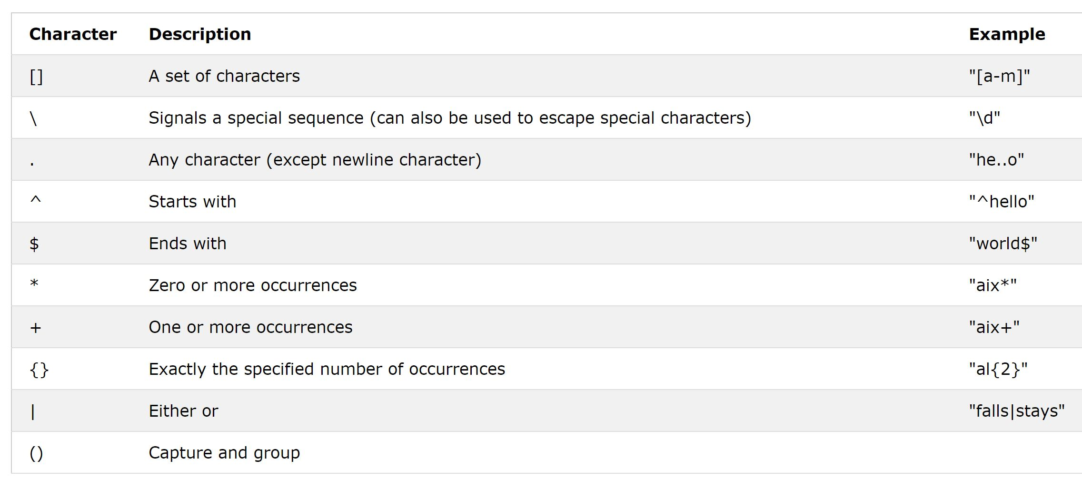
Meta Characters
Metacharacters are characters with a special meaning.

Slide 24
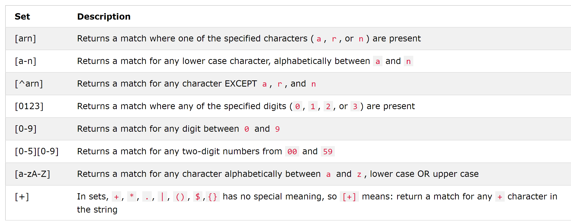
Meta Characters
A set is a set of characters inside a pair of square brackets [] with a special meaning.

Slide 25
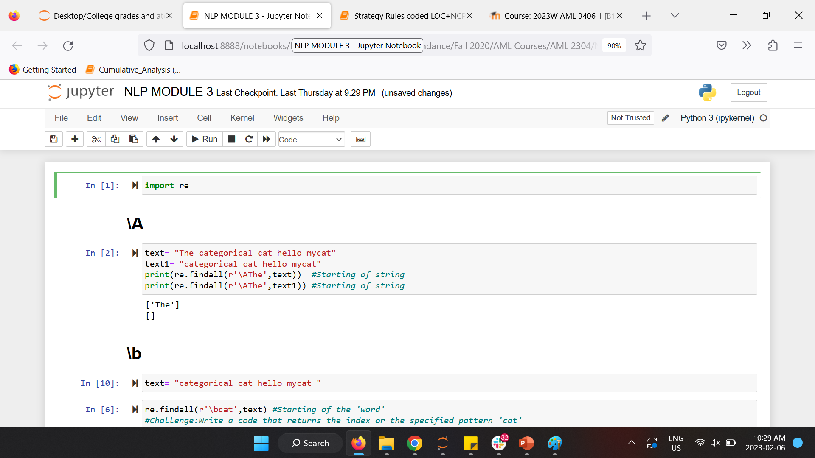
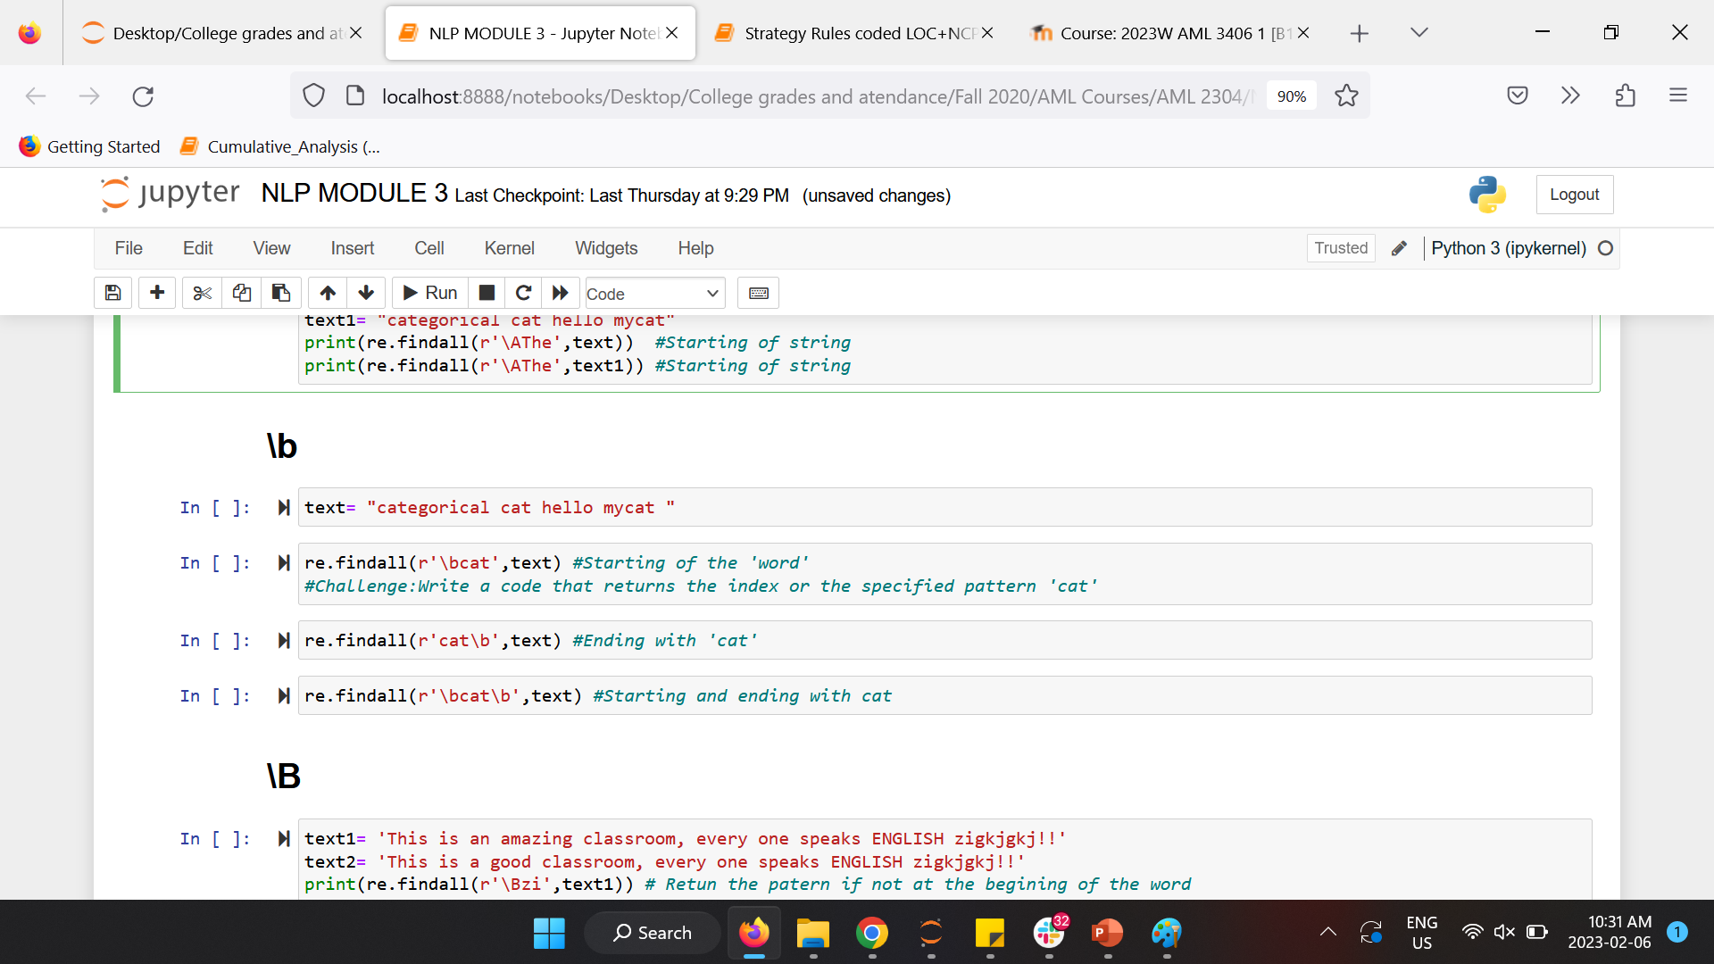
Examples

Slide 26
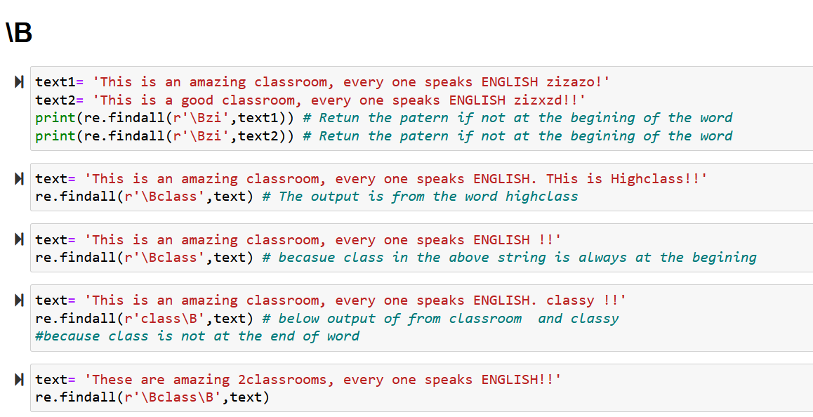
Examples

Slide 27
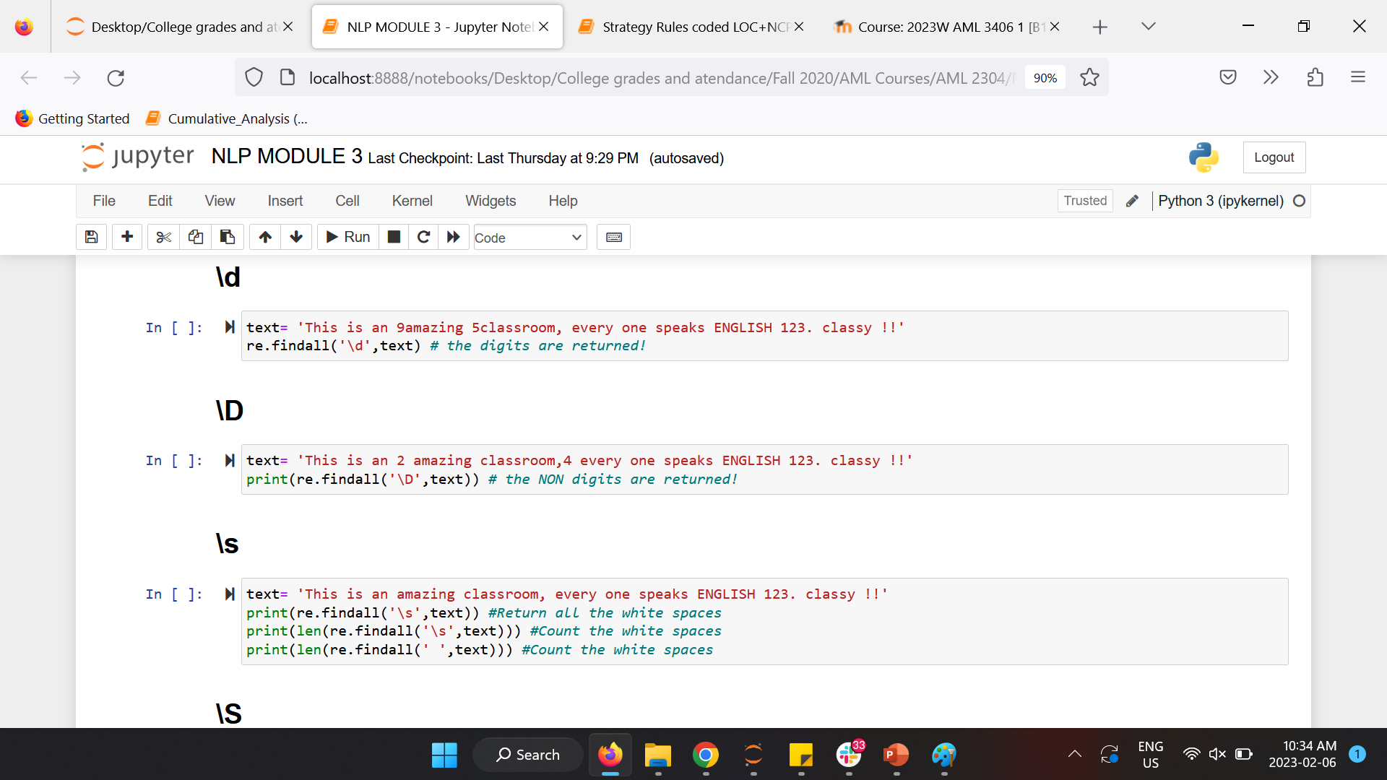
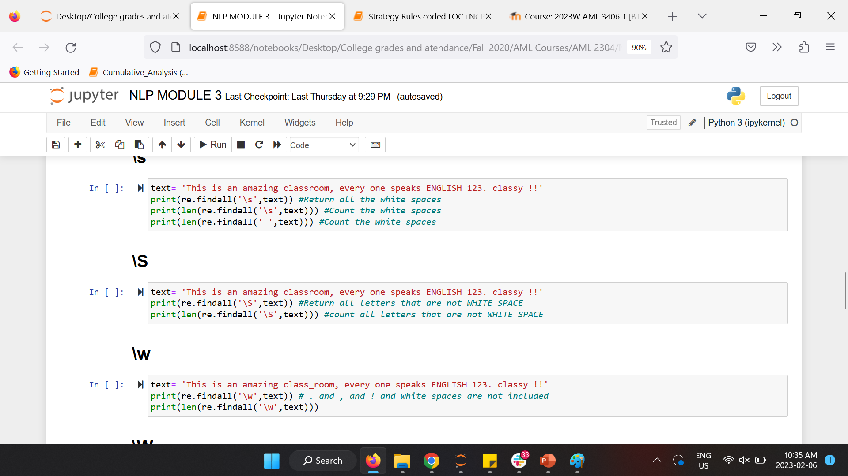
Examples

Slide 28
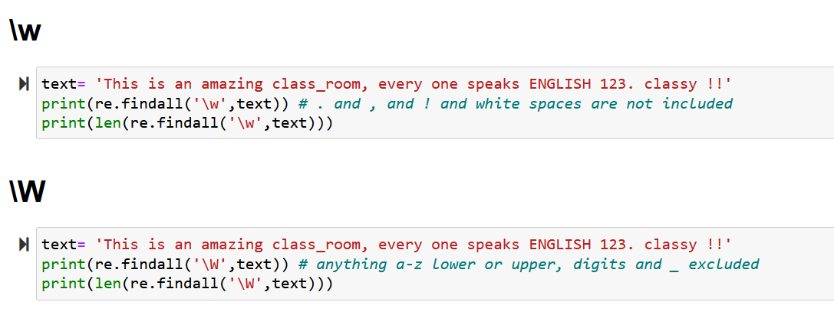
Examples

Slide 29
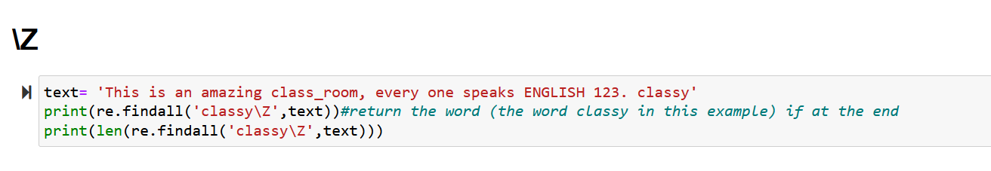
Examples

Slide 30
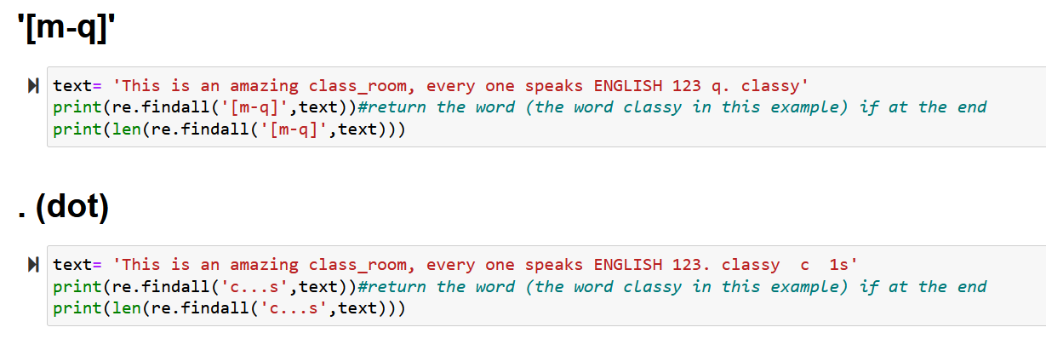
Examples

Slide 31
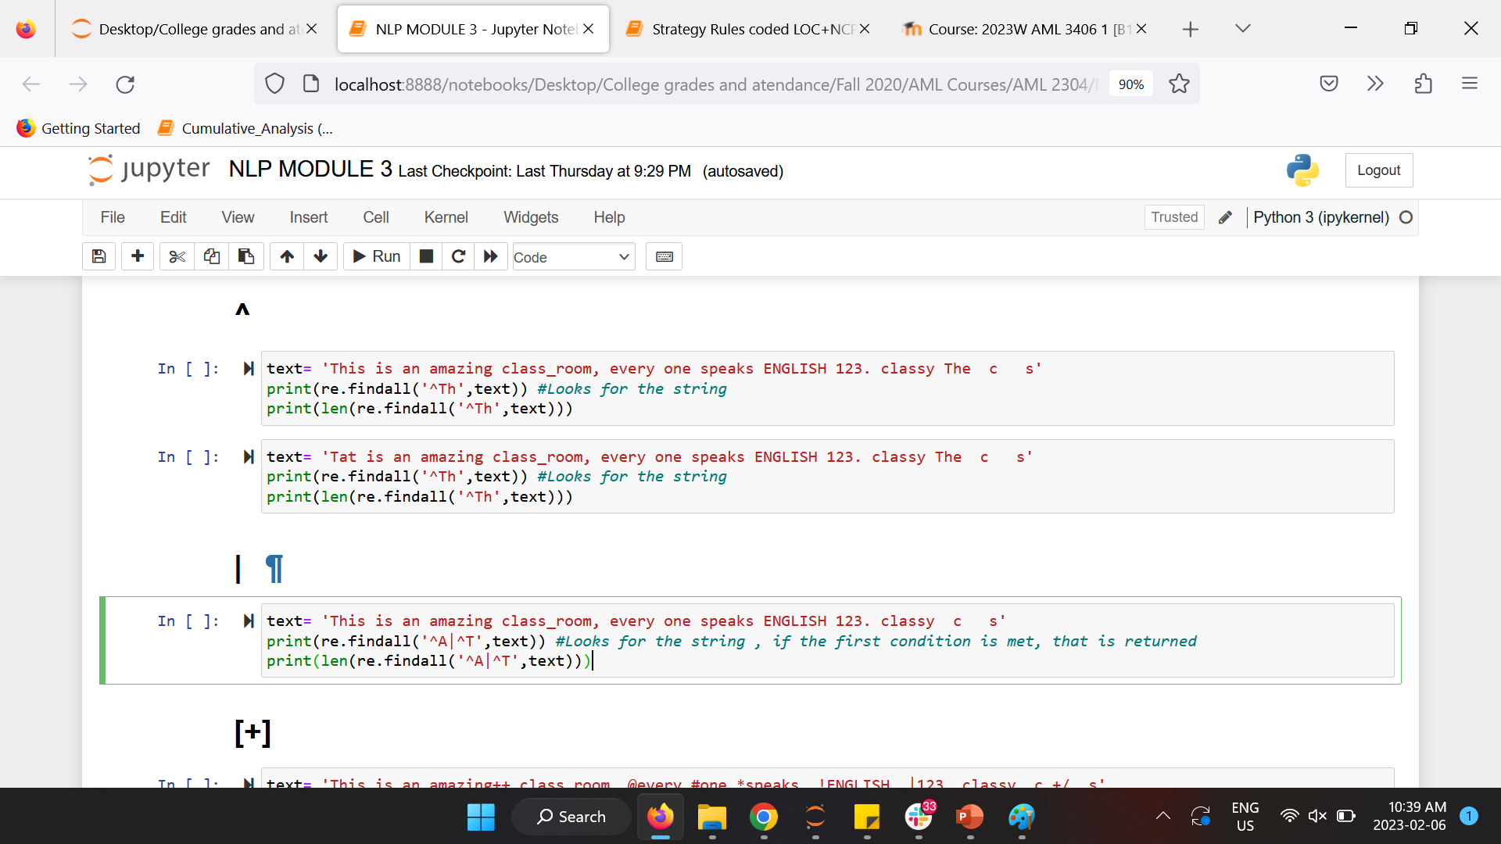
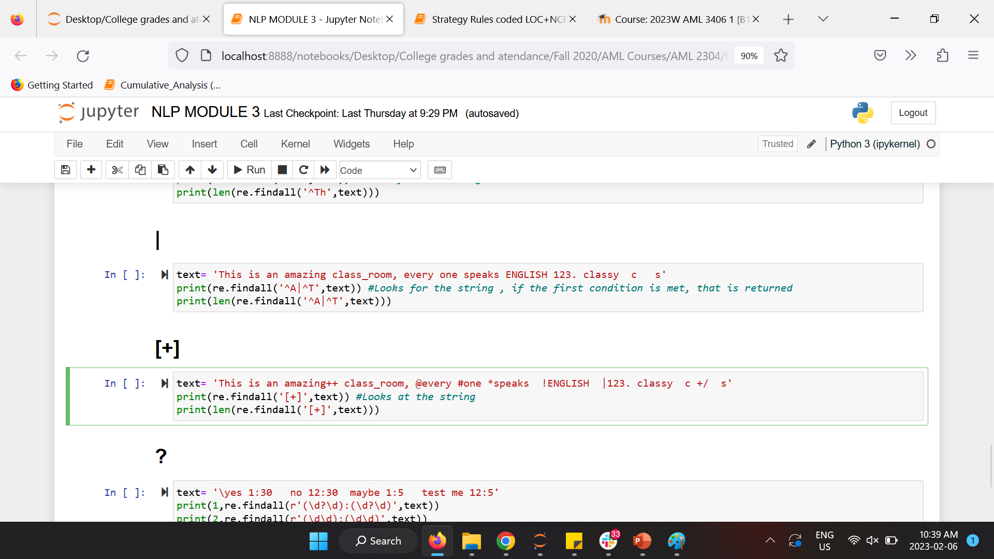
Examples

Slide 32
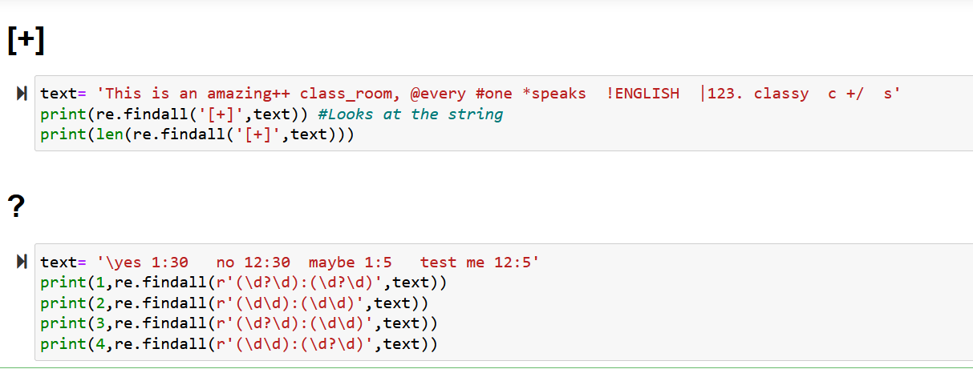
Examples

Slide 33
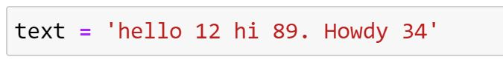
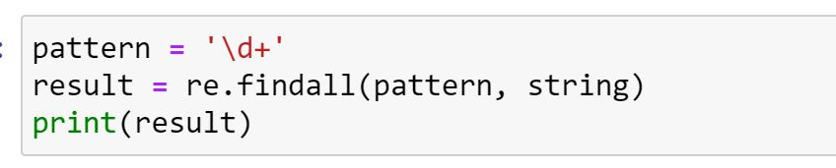
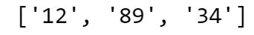
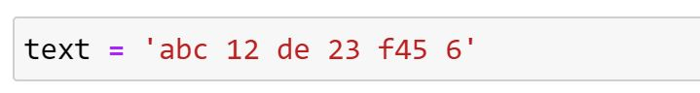
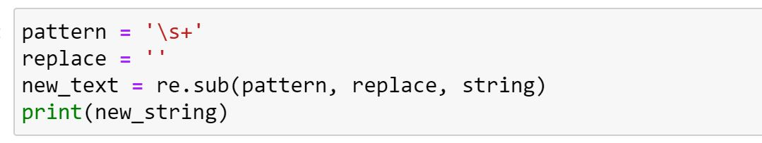
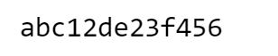
Examples

Slide 34
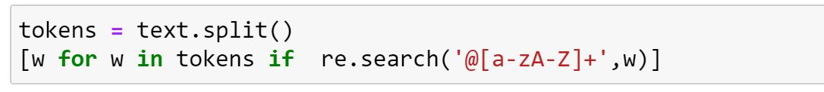
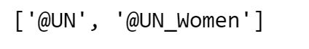
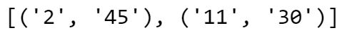
Examples
Challenge Question : What is the role of ‘?’ Run the code without it and discuss the output with a fellow learner
Hint : A regular expression followed by a question mark ( ? ) matches zero or one occurrence of the one-character regular expression

Slide 35
3.7 Explain Bag-of-Words

Slide 36
Bag of Words (BoW) Model
Machine learning algorithms cannot work with raw text directly; the text must be converted into numbers. Specifically, vectors of numbers.
This is called feature extraction or feature encoding.
Bag of words model helps convert the text into numerical representation (numerical feature vectors) such that the same can be used to train models using machine learning algorithms. Here are the key steps of fitting a bag-of-words model:
It involves two things:
Create a vocabulary indices of words or tokens from the entire set of documents. The vocabulary indices can be created in alphabetical order. It is advise to remove stop words, punctuation and etc first, and also perform word normalization before this step!
Construct the numerical feature vector for each document that represents how frequent each word appears in different documents. The feature vector representing each will be sparse in nature as the words in each document will represent only a small subset of words out of all words (bag-of-words) present in entire set of document

Slide 37
Bag of Words (BoW) Model (Example)
Let’s recall the three types of movie reviews we saw earlier:
Document 1 (Review 1): This movie is very scary and long
Document 2 (Review 2): This movie is not scary and is slow
Document 3 (Review 3): This movie is spooky and good
We will first build a vocabulary from all the unique words in the above three reviews. The vocabulary consists of these 11 words:
‘This’, ‘movie’, ‘is’, ‘very’, ‘scary’, ‘and’, ‘long’, ‘not’, ‘slow’, ‘spooky’, ‘good’
We can now take each of these words and mark their occurrence in the three movie reviews above with 1s and 0s. This will give us 3 vectors for 3 reviews:
Vector of Document 1 : [1 1 1 1 1 1 1 0 0 0 0]
Vector of Document 2 : [1 1 2 0 1 1 0 1 1 0 0 ]
Vector of Document 3 : [1 1 1 0 0 1 0 0 0 1 1]

Slide 38
Drawbacks of Bag-of-Words
In the example about movies, we can have vectors of length 11. However, we start facing issues when we come across new sentences:
If the new sentences contain new words, then our vocabulary size would increase and thereby, the length of the vectors would increase too.
Additionally, the vectors would also contain many 0s, thereby resulting in a sparse matrix (which is what we would like to avoid)
We are retaining no information on the grammar of the sentences nor on the ordering of the words in the text in the present example that highlights the importance of some preprocessing before this step.
The words with high frequency, even if they are not important in reality may get higher weight in the model!
Despite the above points, the most significant advantage of the bag-of-words model is its simplicity and ease of use. It can be used to create an initial draft model before proceeding to more sophisticated word embedding.

Slide 39
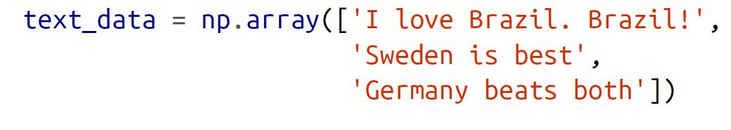
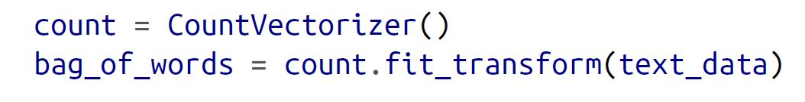
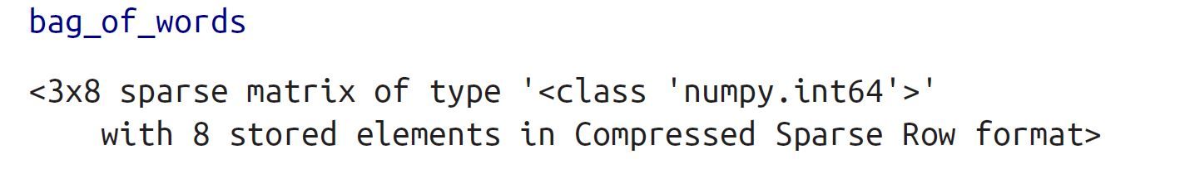
Bag-of-Words
We use scikit-learn’s CountVectorizer to implement bag-of-words.
The output is a sparse matrix

Slide 40

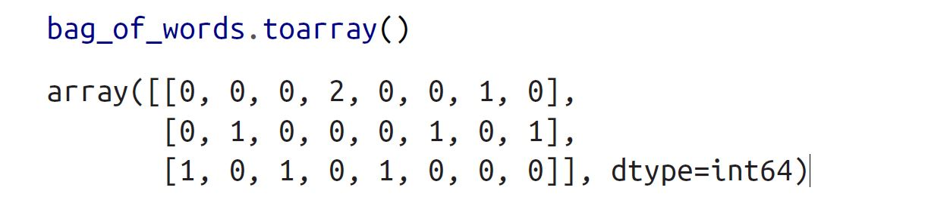
Bag-of-Words
We can use the vocabulary_ method to view the word associated with each feature
We can use toarray to view a matrix of word counts for each observation.

Slide 41
3.8 Discuss TF-IDF

Slide 42
TF-IDF
A problem with scoring word frequency (bag-of-words) is that highly frequent words start to dominate in the document.
Highly frequent words may not contain as much “informational content” to the model as rarer but perhaps domain specific words.
One approach is to rescale the frequency of words by how often they appear in all documents.
the scores for frequent words like “the” that are also frequent across all documents are penalized.
Term Frequency (TF) is a scoring of the frequency of the word in the current document.
Inverse Document Frequency (IDF) is a scoring of how rare the word is across data

Slide 43
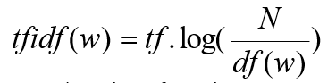
TF-IDF
In the bag-of-words representation each word is represented as a
separate variable having numeric weight (importance)
The most popular weighting schema is normalized word frequency TFIDF:
tf(w) – term frequency (number of word occurrences in a document)
df(w) – document frequency (number of documents containing the word)
N – number of all documents
tfIdf(w) – relative importance of the word in the document
The word is more important if it appears several times in a target document
The word is more important if it appears in less documents

Slide 44
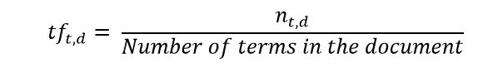
TF-IDF (Example)
Let’s first put a formal definition around TF-IDF. Here’s how Wikipedia puts it:
“Term frequency–inverse document frequency, is a numerical statistic that is intended to reflect how important a word is to a document in a collection or corpus.
Term Frequency (TF)
Let’s first understand Term Frequent (TF). It is a measure of how frequently a term, t, appears in a document, d:
Here, in the numerator, n is the number of times the term “t” appears in the document “d”. Thus, each document and term would have its own TF value.

Slide 45
TF-IDF (Example)
Term Frequency (TF)
Let’s recall the three types of movie reviews we saw earlier:
Document 1 (Review 1): This movie is very scary and long
Document 2 (Review 2): This movie is not scary and is slow
Document 3 (Review 3): This movie is spooky and good
We will again use the same vocabulary we had built in the Bag-of-Words model to show how to calculate the TF for Review #2 as an example : ‘ This movie is not scary and is slow’
Vocabulary: ‘This’, ‘movie’, ‘is’, ‘very’, ‘scary’, ‘and’, ‘long’, ‘not’, ‘slow’, ‘spooky’, ‘good’
Number of words in Review 2 = 8
TF for the word ‘this’ = (number of times ‘this’ appears in review 2)/(number of terms in review 2) = 1/8
Similarly for other words in review # 2 we have :
TF(‘movie’) = 1/8, TF(‘is’) = 2/8 = 1/4, TF(‘very’) = 0/8 = 0
TF(‘scary’) = 1/8, TF(‘and’) = 1/8, TF(‘long’) = 0/8 = 0
TF(‘not’) = 1/8, TF(‘slow’) = 1/8, TF( ‘spooky’) = 0/8 = 0, TF(‘good’) = 0/8 = 0

Slide 46
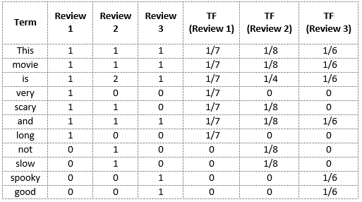
TF-IDF (Example)
Term Frequency (TF)
We can calculate the term frequencies (TF) for all the terms and all the reviews in this manner:

Slide 47
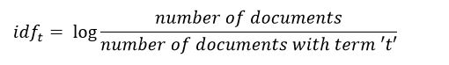
TF-IDF (Example)
Inverse Document Frequency (IDF)
IDF is a measure of how important a term is. We need the IDF value because computing just the TF alone is not sufficient to understand the importance of words:
We can calculate the IDF values for the all the words in Review 2:
IDF(‘this’) = log(number of documents/number of documents containing the word ‘this’) = log(3/3) = log(1) = 0
Similarly,
IDF(‘movie’, ) = log(3/3) = 0 , IDF(‘is’) = log(3/3) = 0
IDF(‘not’) = log(3/1) = log(3) = 0.48 , IDF(‘scary’) = log(3/2) = 0.18
IDF(‘and’) = log(3/3) = 0 , IDF(‘slow’) = log(3/1) = 0.48

Slide 48
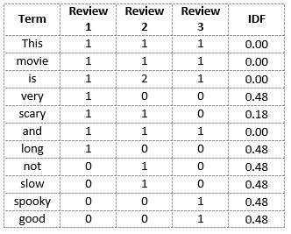
TF-IDF (Example)
Inverse Document Frequency (IDF)
We can calculate the IDF values for each word like this. Thus, the IDF values for the entire vocabulary would be:
Hence, we see that words like “is”, “this”, “and”, etc., are reduced to 0 and have little importance;
while words like “scary”, “long”, “good”, etc. are words with more importance and thus have a higher value.

Slide 49
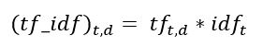
TF-IDF (Example)
TF_IDF :
We can now compute the TF-IDF score for each word in the corpus. Words with a higher score are more important, and those with a lower score are less important:
We can now calculate the TF-IDF score for every word in Review 2:
TF-IDF(‘this’, Review 2) = TF(‘this’, Review 2) * IDF(‘this’) = 1/8 * 0 = 0
Similarly,
TF-IDF(‘movie’, Review 2) = 1/8 * 0 = 0
TF-IDF(‘is’, Review 2) = 2/8 * 0 = 0
TF-IDF(‘not’, Review 2) = 1/8 * 0.48 = 0.06
TF-IDF(‘scary’, Review 2) = 1/8 * 0.18 = 0.023
TF-IDF(‘and’, Review 2) = 1/8 * 0 = 0
TF-IDF(‘slow’, Review 2) = 1/8 * 0.48 = 0.06

Slide 50
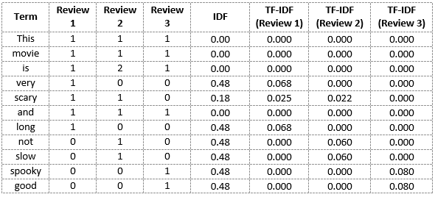
TF-IDF (Example)
Similarly, we can calculate the TF-IDF scores for all the words with respect to all the reviews:
We have now obtained the TF-IDF scores for our vocabulary.
TF-IDF also gives larger values for less frequent words and is high when both IDF and TF values are high i.e the word is rare in all the documents combined but frequent in a single document

Slide 51
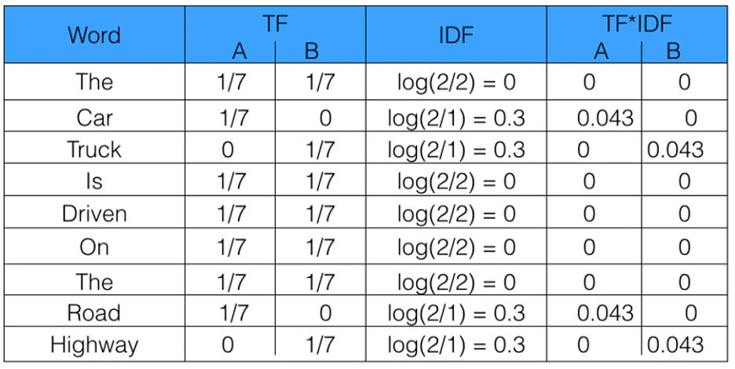
TF-IDF (Another Example)
A = “The car is driven on the road”
B = “The truck is driven on the highway”

Slide 52

TF-IDF
We use scikit-learn’s TfidfVectorizer to implement bag-of-words.
Please review the documentation :
https://scikit-learn.org/stable/modules/generated/sklearn.feature_extraction.text.TfidfVectorizer.html

Slide 53


TF-IDF
We can use .toarray to see the feature matrix.
We can use the vocabulary_ method to view the word associated with each feature

Slide 54
Bag of Words vs TF-IDF
Let ‘s summarize what we’ve covered in the part:
Bag of Words just creates a set of vectors containing the count of word occurrences in the document (reviews), while the TF-IDF model contains information on the more important words and the less important ones as well.
Bag of Words vectors are easy to interpret. However, TF-IDF usually performs better in machine learning models.
While both Bag-of-Words and TF-IDF have been popular in their own regard, there still remained a void where understanding the context of words was concerned. Detecting the similarity between the words ‘spooky’ and ‘scary’, or translating our given documents into another language, requires a lot more information on the documents.
This is where Word Embedding techniques such as Word2Vec, Continuous Bag of Words (CBOW), Skipgram, etc. come in. (Self study topics)

Slide 55
Any questions so far? Any comments?

